Slide 1
ENSE 470, Milestone 3
Group Eh?
Nickolas Schmidt, Quinn Bast, Abdulaziz Alghamdi,
February 1st 2018

Slide 2
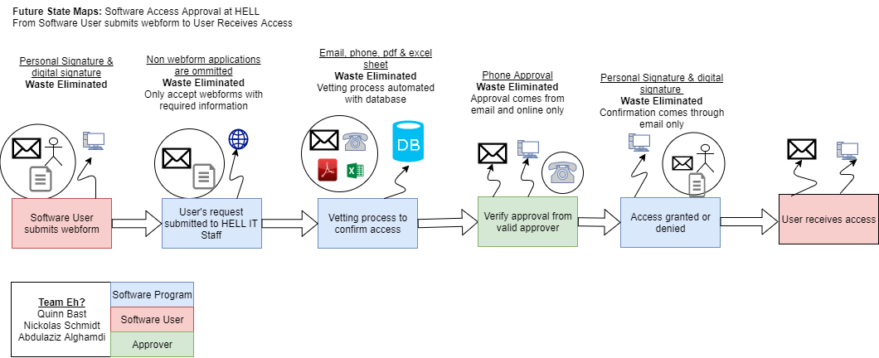
Recall, future state VSM

Slide 3
As a User I would like to…
As a user I would like to be notified when my request is sent
Submit a webform for access to a piece of software
Be notified when access is approved or denied

Slide 4
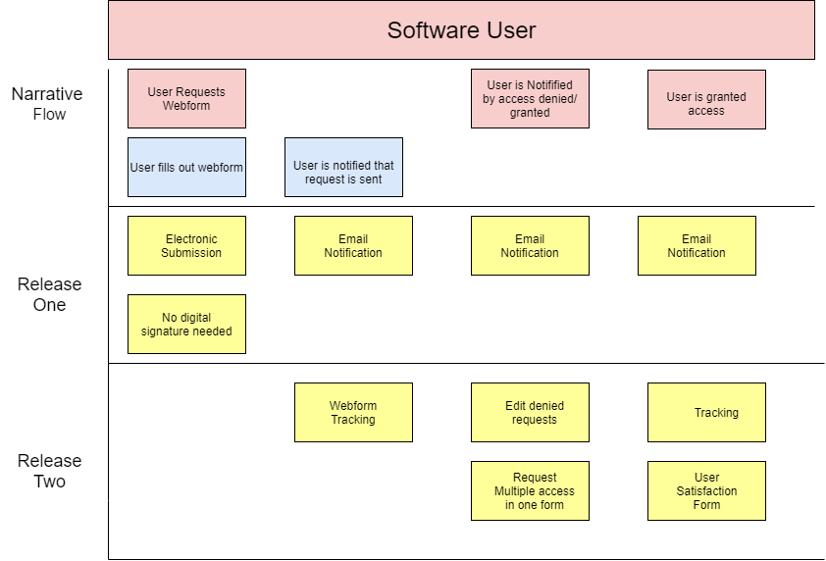

Slide 5
As a Software Approver I would like to…
…only handle electronic submissions to eliminate paperwork and streamline the process.
…be able to request additional information from the user to avoid denying requests that lack information.
…have all the user’s information available in order to accurately approve or deny tickets.
…not have to physically sign software approvals in order to avoid clutter and save time.
…be able to forward an application request to a superior to avoid redundant communication.
…view previous application requests to maintain a history of application access.
…be notified by email when I am required to approve a ticket to avoid ignoring tickets.
…approve or deny a user access to a software to perform my duty as a software approver.
…easily search and filter submissions to make finding specific tickets easier.

Slide 6
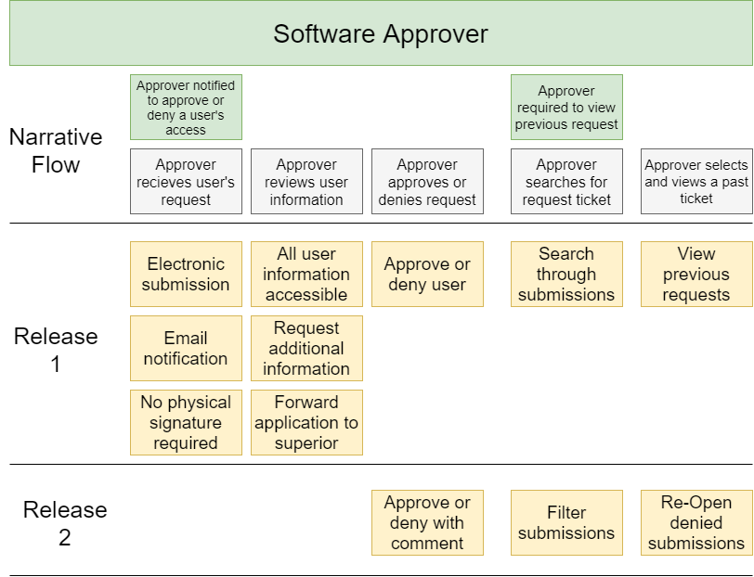

Slide 7
As a member of the HELL IT Staff I would like to…
be notified when there are new submission to queue it
be able to review the forms to check the requirement
be able to contact the user to ask for additional information

Slide 8
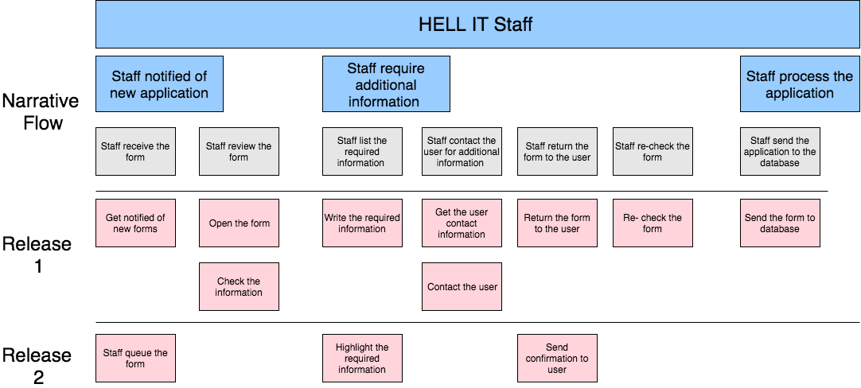

Slide 9
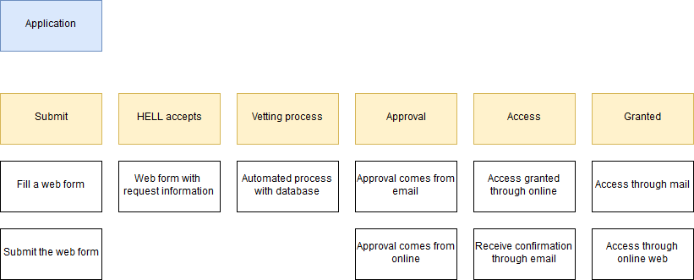
User Story Map

Slide 10
Group reflection
How did you feel about this milestone? What did you like about it? What did you dislike?
The milestone was enjoyable to make, it was nice to take a topic we learned in a previous class and expand on it by creating a user story map.
What did you learn about yourself as you collaborated and worked through this milestone?
We each had our own version of how the USM would look and it was interesting to collaborate our ideas into the design we showed today.
How will you use what you have learned going forward?
The user story map really breaks down what we will need to code and how the structure of the program will look
What “stuff & things” related to this milestone would you want help with?
The User Story Map was the first thing of real depth we needed to accomplish and it was enjoyable to plan it out in our own way and create it.

